Slide 1
Insert Final Diagnosis
**Save with File Name “Capture 3DR Case of the Week – Final Diagnosis (First Author Last Name)”
First Name Last Name, Credentials
Institution Name, City, State/Country
First Name Last Name, Credentials
Institution Name, City, State/Country
First Name Last Name, Credentials
Institution Name, City, State/Country
Move “Corresponding Author” arrow icon up to correct name
Insert email address here: XYZ@XYZ.com
Corresponding Author
Notes:
Example:
John Smith, DDS, MS, MAGD
Department of Diagnostic Radiology, University of X, Anytown, State/Country
Authorship: Author order indicates the magnitude of contribution, with the first author adding the most value and the last author representing the most senior, predominantly supervisory role.

Slide 2
Case History
Demographics / Relevant History / Current Signs & Symptoms / Clinical Photos (insert below)
(Insert here)
Photos for these are optional
A
B
C
Notes:
Case History sentence should be brief and in this format:
“A [insert demographics] presented with [relevant history / time frame of signs & symptoms of current condition].”
Note: Unlike with Imaging slide (NEXT SLIDE), a separate Figure Legend is not required since photos are optional; however, if used, please reference the relevant photos within the body of the Case History write-up with a sentence as such: “…patient initially presented to the clinic X months ago with [insert clinical finding] (A).”

Slide 3
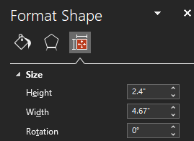
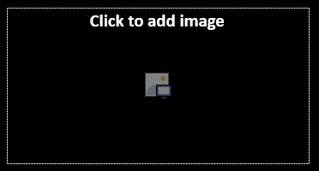
Imaging
If adding a pano image, convert 1 square to a rectangle (Height and Width below), then delete 1 of the squares – Ex. if 1 pano used, 5 images maximum can be added to this slide
A-C required;
D-F are optional
A
B
C
D
E
F
Figure Legend (insert below)
(Insert here)
Notes:
Should be brief and in this format:
“Axial CBCT (A) demonstrates mild-to-moderate…(red arrow). Sagittal CBCT (B) and Coronal CBCT (C) demonstrate…(orange and yellow arrows, respectively). Axial T1W1 (D) demonstrates…(green arrow).”
Note: If major incidental findings are part of image used, annotate in Figure Legend.

Slide 4
Diagnosis
Impression (Lesion Category) (insert below) - Note: See Notes for options; editors will verify / modify as needed
Insert Impression here
Differential Diagnosis (insert below) - Note: 3 Differential Diagnoses need to fit within the Impression (Lesion) Category above to be valid options
Insert #1 Differential
Features why
Insert #2 Differential
Features why less likely
Insert #3 Differential
Features why less likely
Final Diagnosis (insert below)
Insert #1 Differential
Notes:
Impression (Lesion Category) options (usually should be 1, 2nd is optional if needed)
Cyst
Odontogenic
Non-odontogenic
Benign Neoplasm
Odontogenic
Non-odontogenic
Bone Dysplasia
Systemic
Inflammatory
Malignant Neoplasm
Vascular Abnormalities
Craniofacial Anomalies
Trauma
Salivary Gland Disease
Paranasal Sinuses
TMJ Abnormalities
Dental Anomalies
Soft Tissue Calcifications
Temporal Bone Lesions

Slide 5
Summary
Key Radiographic Features vs. Case Findings (insert below) – See notes for guidance
Location
(Insert here)
Periphery and Shape
(Insert here)
Effects on Surrounding Structures
(Insert here)
Internal Structure
(Insert here)
Management (insert below) – See notes for guidance
Biopsy (if indicated)
(Insert here)
Advanced Imaging (if indicated)
(Insert here)
Surgical / Treatment options (if indicated)
(Insert here)
Notes:
Key Features
State the typical Key Features (as if the lesion “read the book”) of your Final Diagnosis and compare them to your actual findings, with special attention / elaboration on features that do not match with your Final Diagnosis
Management
State what was done / what still needs to be done:
Biopsy – what type (aspirational, etc.) and why?
Advanced Imaging – what type and why?
Surgical / Treatment options – what type and why?

Slide 6
Summary (cont.)
Photos / Images for these are optional
If pano used, follow same resizing and delete 1 instructions found on Imaging slide
A
B
C
Biopsy (Gross specimen) / Histopathology / Follow-up Legend (optional) (insert below) – See notes for guidance
(Insert here)
Suggested Readings (insert below) – See notes for guidance
Insert MLA9-formatted citation here
Insert MLA9-formatted citation here
Insert MLA-formatted citation here
Notes:
Biopsy (Gross specimen) / Histopathology / Follow-up Legend (optional)
Should be brief and in this format: “Gross specimen (A) demonstrates…(red arrow). Histopathological slide with Hematoxylin and Eosin staining (B) shows…(blue arrow). Panoramic image 6 months post-op (C) demonstrates… .”
Note: If major incidental findings are part of image used, annotate in Figure Legend.
Citations should be MLA 9th edition formatted – use this site: https://www.citationmachine.net/

Slide 7
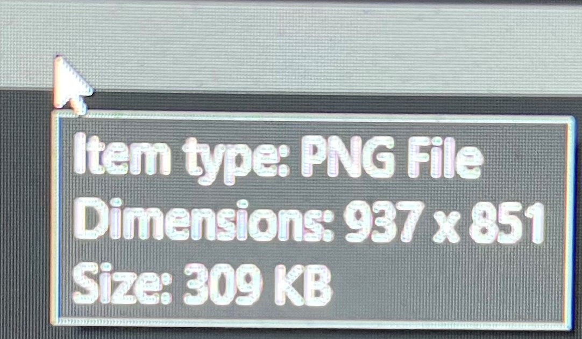
Image Qualities
File Types: .PNG, JPEG, or .TIFF
Original Shape: Ensure close to square-shaped
Note: Insertion into template will force square shape, so pre-center/crop appropriately
Size: No less than 800 Pixels x 800 Pixels
Unaltered: Not blurry, distorted, or stretched
Labels: A-F
Note: Insertion into template will auto-label
Section-specific requirements
Imaging: required
Case History and Management: optional
Arrows: Identify points of interest
Note: Drag into inserted photo
Colors: Red, Orange, Yellow, Green, Blue, and Pink (refer to them as this in Figure Legend)
If republished, attribution and permission to use must be included in the associated Figure Legend
These two #’s must be > 800

